Slide 1

BUSINESS INTELLIGENCE & DECISION SUPPORT
Gold Price Analysis with Power BI
Historical price and volume analysis of Gold, sourced from TradingView and Investing.com, with a 90-day forward forecast built in Power BI.
Mohammed Shuraim – 100004772
Vishal Biradar – 100004925
Sourav Shekhar Naik – 100004311
Medamaranahally Girish Suhas–100003129
Prof. Dr. Dany Djeudeu
Notes:
Fill in team member names before submitting. This deck reflects only what was actually built: Power BI dashboard on real Gold data, and the Meridian live monitoring site.

Slide 2

ROADMAP
01
The Problem
Why gold price unpredictability matters for hedging and procurement
02
Data Sources
TradingView and Investing.com — what each one actually provides
03
The Power BI Dashboard
Real price and volume trends built from our dataset
04
The 90-Day Forecast
How Power BI's built-in forecast works, and what it produced
05
Status, SCM Relevance & Next Steps
What's done, what's left, and why this matters beyond trading
2
Notes:
Keep this section simple and honest — no modeling jargon here, just the real structure of the work.

Slide 3
THE PROBLEM
Why Gold Price Forecasting Matters
Gold is a widely used hedge against inflation and economic uncertainty, but its price is volatile and shaped by macroeconomic shocks that are hard to anticipate from intuition alone. Traders, financial institutions, and businesses that use gold as a raw material all face the same challenge: without a forecast, decisions about when to buy, sell, or hedge are made blind.
Unpredictability
Suboptimal Timing
Unmitigated Risk
Sharp price swings driven by macro shocks are difficult to anticipate.
Without a forecast, buying and hedging decisions are made reactively, not proactively.
Exposure to downside price movement is hard to quantify without historical analysis.
3
Notes:
Keep this framed as a general, defensible business motivation — not tied to any specific model claims.

Slide 4
DATA FOUNDATION
Where Our Data Actually Comes From
TradingView
Investing.com
Powers our live Meridian market terminal (see next slide) — real-time price charts, a technical gauge, symbol info, and an economic calendar via TradingView's own embeddable widgets. This is a live monitoring layer, not a source of historical data used in our model.
Source of the daily historical Gold price series (Open, High, Low, Close, Volume) used in our Power BI dashboard and forecast — this is the real data behind everything in this deck.
Dataset Snapshot
2,081
Jan 2017 – Jul 2026
$1,162 – $5,355
Daily Rows
Date Range
Price Range (Close)
4
Notes:
These numbers are pulled directly from the real, cleaned dataset — not from any other team's paper. If your Power BI report shows slightly different totals due to filters, use those instead.

Slide 5
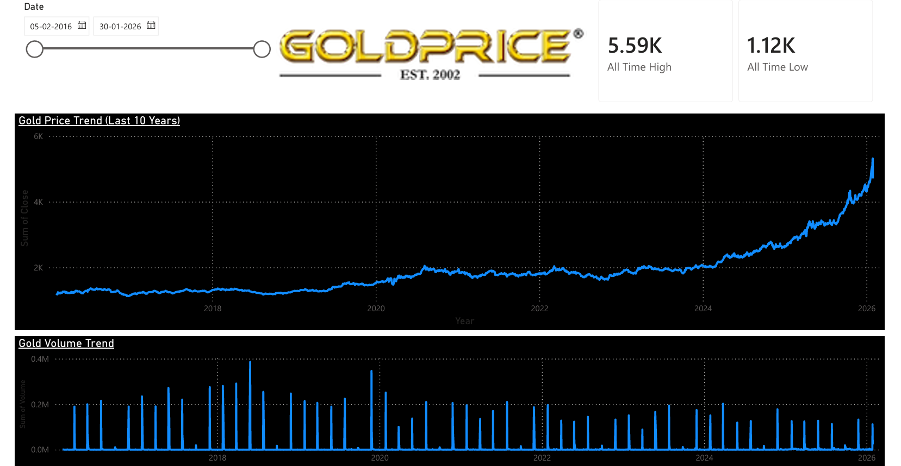
POWER BI · HISTORICAL ANALYSIS

Slide 6
MERIDIAN · LIVE TRADING TERMINAL
Real-time chart, technical gauge, symbol info & economic calendar
Built on official TradingView widgets
•Advanced candlestick chart (15M interval)
•Multi-asset market overview (crypto, equities, forex, futures)
•Technical analysis gauge (buy/sell/neutral signal)
•Live economic calendar for macro events
Role: monitoring layer — where forecasts will surface once the AI agent is connected.
MERIDIAN // Live Market Terminal
code script.txt

Slide 7
THE FORECAST
90-Day Gold Price Forecast (Power BI)
How It Was Built — Simply
Built using Power BI's native Analytics pane → Forecast feature on the Gold price line chart — no custom code.
This feature uses Exponential Smoothing (ETS) — a standard statistical method that automatically detects trend and seasonality in the historical price line and projects it forward.
All settings were left at Power BI's defaults (default confidence interval, automatic seasonality detection).
8
Notes:
This slide intentionally leaves the real forecast values and chart out — insert your actual Power BI screenshot here and narrate the specific numbers live, since those weren't legible enough for me to transcribe accurately.

Slide 8
PROJECT STATUS
Where We Are, What Remains
✓ Completed
○ Remaining
Sourced Gold price history from Investing.com (2017–2026, daily)
Found and corrected a real date-formatting error in the raw data
Built a Power BI dashboard with Price and Volume trend visuals
Generated a 90-day forecast using Power BI's built-in Forecast feature
Built Meridian, a live TradingView-based market monitoring terminal
Validate the forecast against actual prices as new days arrive, to see how accurate it turns out to be
Extend the Power BI report to cover Volume and Price side by side on one page
Explore connecting Meridian's live feed to the Power BI report for a single unified view
Consider a simple written explanation of forecast confidence for non-technical readers
10
Notes:
This replaces the previous, overreaching roadmap (AI agents, multi-model comparisons) with a grounded list of what was actually done and what's realistically next.

Slide 9
INTERPRETATION
How to Read the Forecast
Forecast horizon | 90 days, starting from the last actual data point (21 July 2026)
Method | Exponential Smoothing (ETS) — trend + seasonality projected forward, default settings
Shaded band | Power BI's default confidence interval — shows the range of likely outcomes, not a single guaranteed price
Why the band widens | Uncertainty compounds the further out you forecast — near-term days are more reliable than day 90
What it does NOT capture | Sudden macro shocks, geopolitical events, or central bank actions — ETS only projects patterns already present in the historical price line
9
Notes:
This slide gives you the vocabulary to explain the forecast confidently in Q&A, without needing the exact numbers filled in yet.

Slide 10
BROADER RELEVANCE
Why This Matters for Supply Chain Management
Gold isn't only a trading asset — it's a raw material input, a hedge instrument, and a proxy for currency risk across global supply chains.
Procurement & Input Costs
Currency & Inflation Hedging
Inventory & Working Capital
Electronics, jewelry, and medical-device manufacturers use gold as a raw material; a price trend view helps inform when to place supplier orders.
Gold often serves as a hedge against currency and inflation risk; monitoring its trend supports broader financial risk planning.
A rising price trend can support buying ahead of need; a falling trend favors just-in-time purchasing of gold-containing components.
11
Notes:
Kept intentionally general and defensible — this framing does not depend on any specific model or number, so it's safe to keep even after removing the wrong data.

Slide 11
FROM INSIGHT TO ACTION
Recommendations
Use the Forecast for Planning, Not Certainty
Treat the 90-day forecast as a directional signal for timing decisions — not a guaranteed price.
Re-run the Forecast Regularly
Refresh the Power BI forecast as new daily prices come in, so it stays anchored to recent trends.
Track Forecast Accuracy Over Time
Compare each forecast against what happens, to build confidence in how reliable it is.
Keep Meridian and Power BI Connected in Spirit
Use Meridian for live monitoring and Power BI for trend analysis and forecasting — two complementary views of the same asset.
12
Notes:
Simple, grounded recommendations that follow directly from what was actually built — no invented hedging rules tied to models we didn't build.

Slide 12
CONCLUSION
We built a real, working view of Gold's price and volume history (2017–2026) in Power BI, sourced from Investing.com.
Using Power BI's built-in forecasting, we projected the price trend 90 days forward from 21 July 2026.
Meridian gives us a live, complementary monitoring layer built on TradingView's own widgets.
Notes:
Close simply and honestly — this reflects exactly what was built, nothing more.

Slide 13
GOLD PRICE ANALYSIS . POWER BI
Thank You
Questions & Feedback are Welcome

